Slide 1
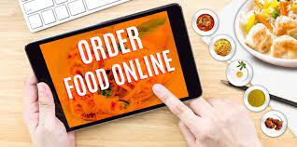
Online Food Ordering System
By:
Java B1 Group-7

Slide 2
Admin
Admin:
• Add Food Items: Admin can add food items details like name, Photo, Description/ Ingredients,
Price, Category etc.
• View / Edit (Price, Enable/Disable) / Delete Items: Admin can view, edit the food items details as
well as Enable/Disable food items according to season or availability.
• View Orders: Admin can track Live orders and Status Update for particular food delivery.
• View Transactions: View previous transaction by date search and total amount at end.
• View Users: Admin can view the users details which are given during registration.

Slide 3
User
User:
• Register: User have to register with essential details for food ordering system.
• Login: User have to login with their credentials to access food ordering system.
• Menu List: Different food items with respective categories viewable to user.
• Item Details: User can view food items details and buy the product by doing online payment.
• View Cart: User can view their cart details, delete food items from cart, update quantity etc.
• View Orders and Status: User can keep track of their orders with delivery status.

Slide 4
Requirements
Software Requirement:
Windows 10
Eclipse
Notepad++.
My SQL / MongoDB
Angular/Java/ Springboot/Microservices/AWS

Slide 5
Team Plan
Total 5 members
So we have to work using below technologies
Frotntend-2members(Akshay, Narayana)
Backend-2members (Java)(Thanmayi, Mahendra)
Database and Documentation-1person (Keerthana)
Testing done by developers/other colleague.

Slide 6
Resouce collected till date
https://www.freeprojectz.com/project-report/3357
Reference report for better understanding.

Slide 7


